Slide 1


Awesome chocolates
Chocolate Sale Analysis Report
Data Analyst - Jatin Bhavsar
Using
SQL
Database - MySQL

Slide 2


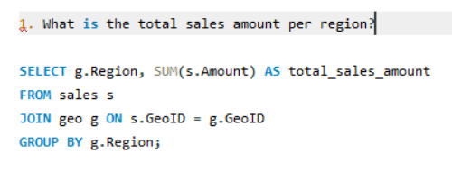
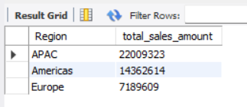

Question 1
What is the total sales amount per region?
Answer
SQL query -
Result -

Slide 3
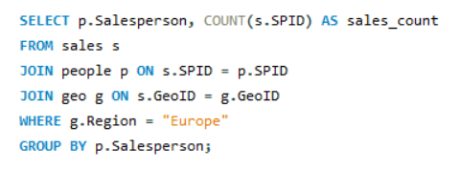
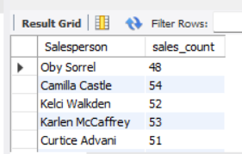
Question 2
How many sales were made by each salesperson in a Europe
region?
Answer
SQL query -
Result -

Slide 4
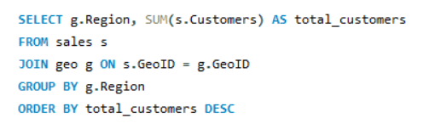
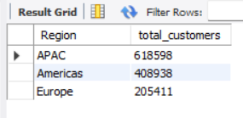
Question 3
Which region has the highest number of customers?
Answer
SQL query -
Result -

Slide 5
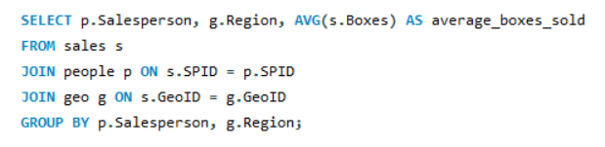
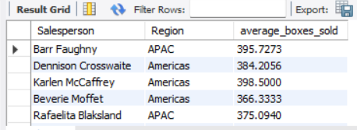
Question 4
What is the average number of boxes sold by each salesperson per region?
Answer
SQL query -
Result -

Slide 6
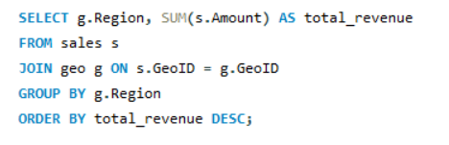
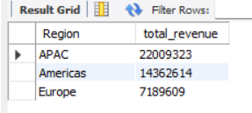
Question 5
Which region generates the highest revenue?
Answer
SQL query -
Result -

Slide 7
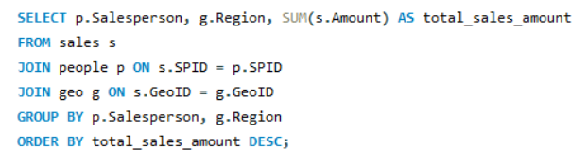
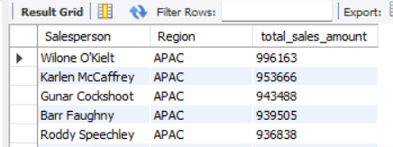
Question 6
What is the most successful salesperson in terms of total sales amount per region?
Answer
SQL query -
Result -

Slide 8
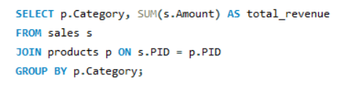
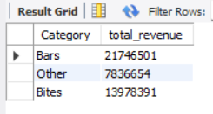
Question 7
What is the total revenue generated by each product category?
Answer
SQL query -
Result -

Slide 9
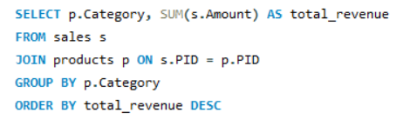
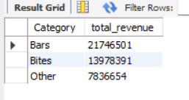
Question 8
Which product category brings in the most revenue?
Answer
SQL query -
Result -

Slide 10
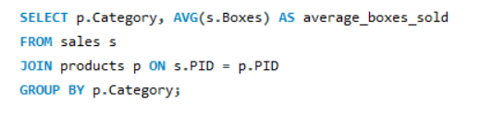
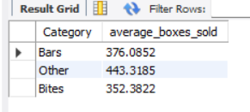
Question 9
What is the average number of boxes sold per product category?
Answer
SQL query -
Result -

Slide 11
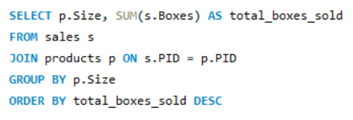
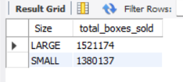
Question 10
What is the best-selling product size?
Answer
SQL query -
Result -

Slide 12
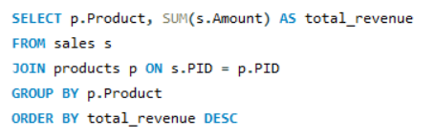
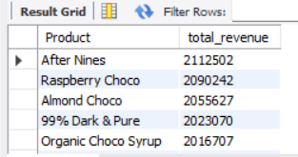
Question 11
Which product has the highest sales revenue?
Answer
SQL query -
Result -

Slide 13
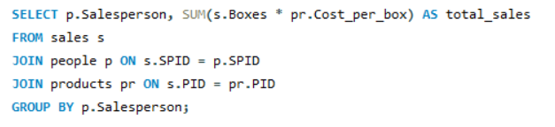
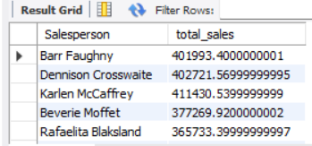
Question 12
What is the total cost of products sold by each salesperson?
Answer
SQL query -
Result -

Slide 14
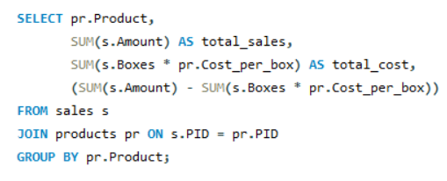
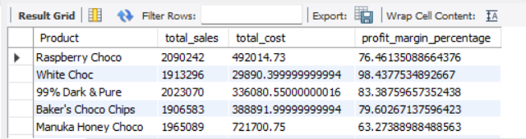
Question 13
What is the profit margin of each product based on its sales and cost per box?
Answer
SQL query -
Result -

Slide 15
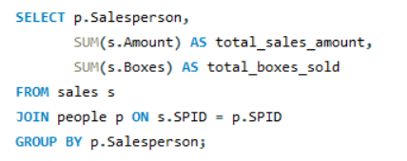
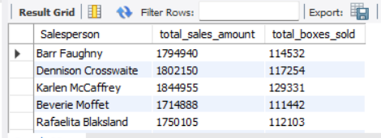
Question 14
What is the total sales amount and number of boxes sold per salesperson?
Answer
SQL query -
Result -

Slide 16
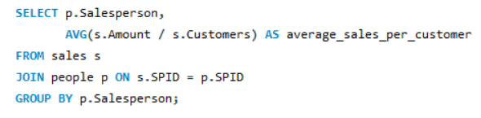
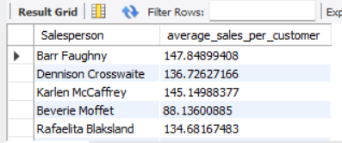
Question 15
What is the average sales amount per customer per salesperson?
Answer
SQL query -
Result -

Slide 17
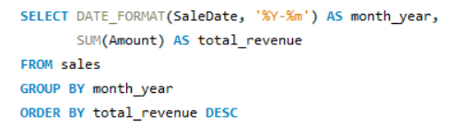
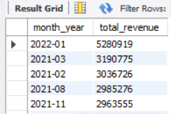
Question 16
Which year_month had the highest revenue generated?
Answer
SQL query -
Result -

Slide 18
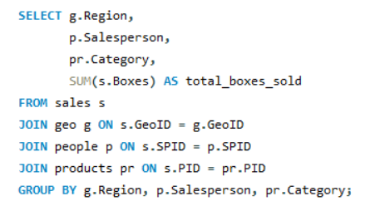
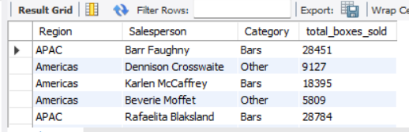
Question 17
What is the total number of boxes sold per region, salesperson, and product category?
Answer
SQL query -
Result -

Slide 19
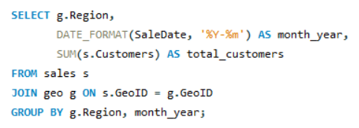
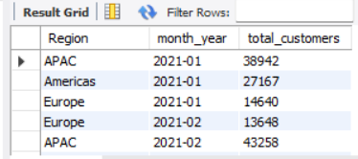
Question 18
How does the number of customers change across different regions over time?
Answer
SQL query -
Result -

Slide 20
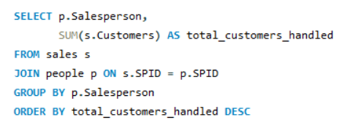
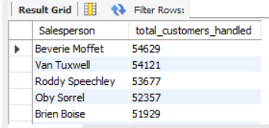
Question 19
Which salesperson handled the highest number of customers?
Answer
SQL query -
Result -

Slide 21
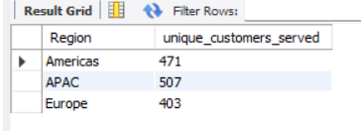
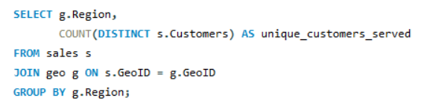
Question 20
How many unique customers were served in each region?
Answer
SQL query -
Result -

Slide 22
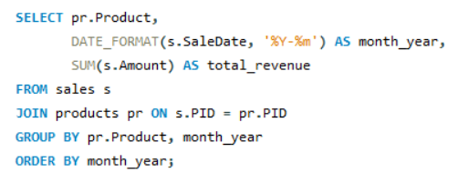
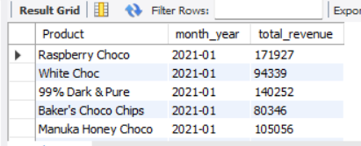
Question 21
What is the revenue trend for different products over time?
Answer
SQL query -
Result -

Slide 23
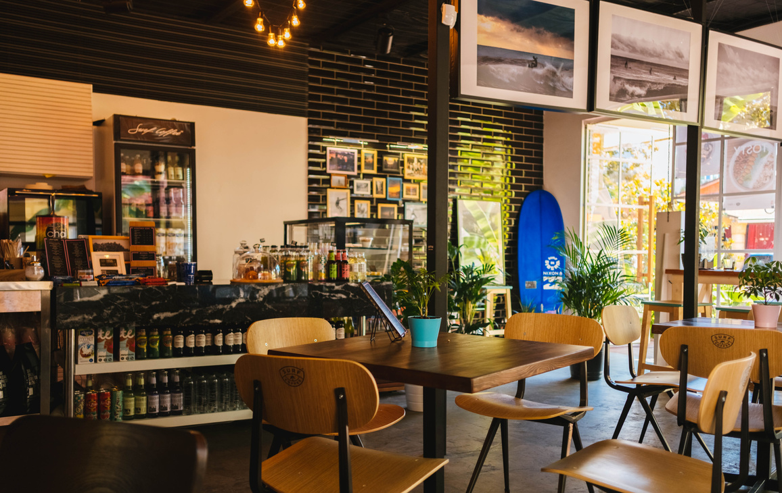
THANK YOU
Phone Number
Email
9924750166
hello@reallygreatsite.com
Website
Address
www.reallygreatsite.com
Ahmedabad, India

